Slide 1
Introduction to Robotics
CSE461
BRAC University

Slide 2
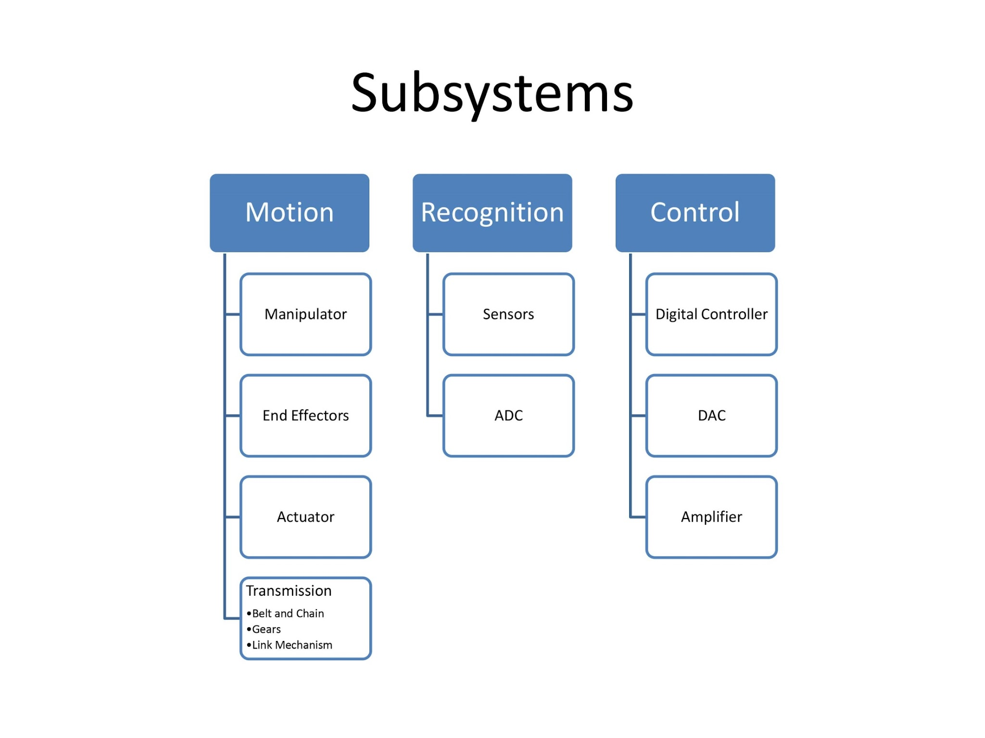

Slide 3
Motion

Slide 4
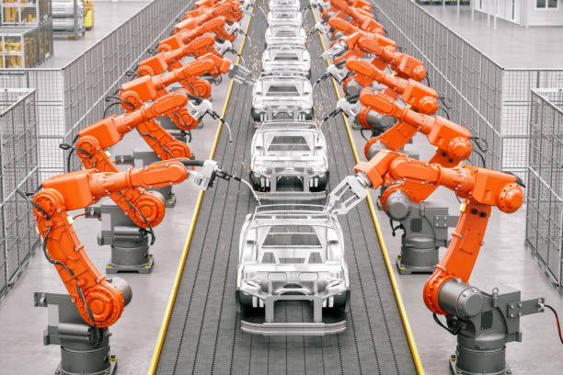

Slide 5
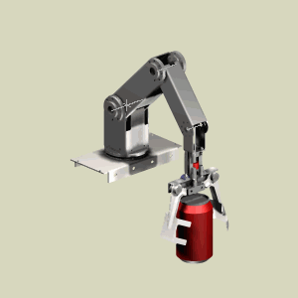
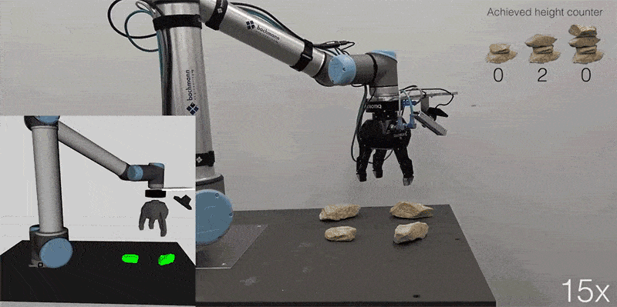

Slide 6
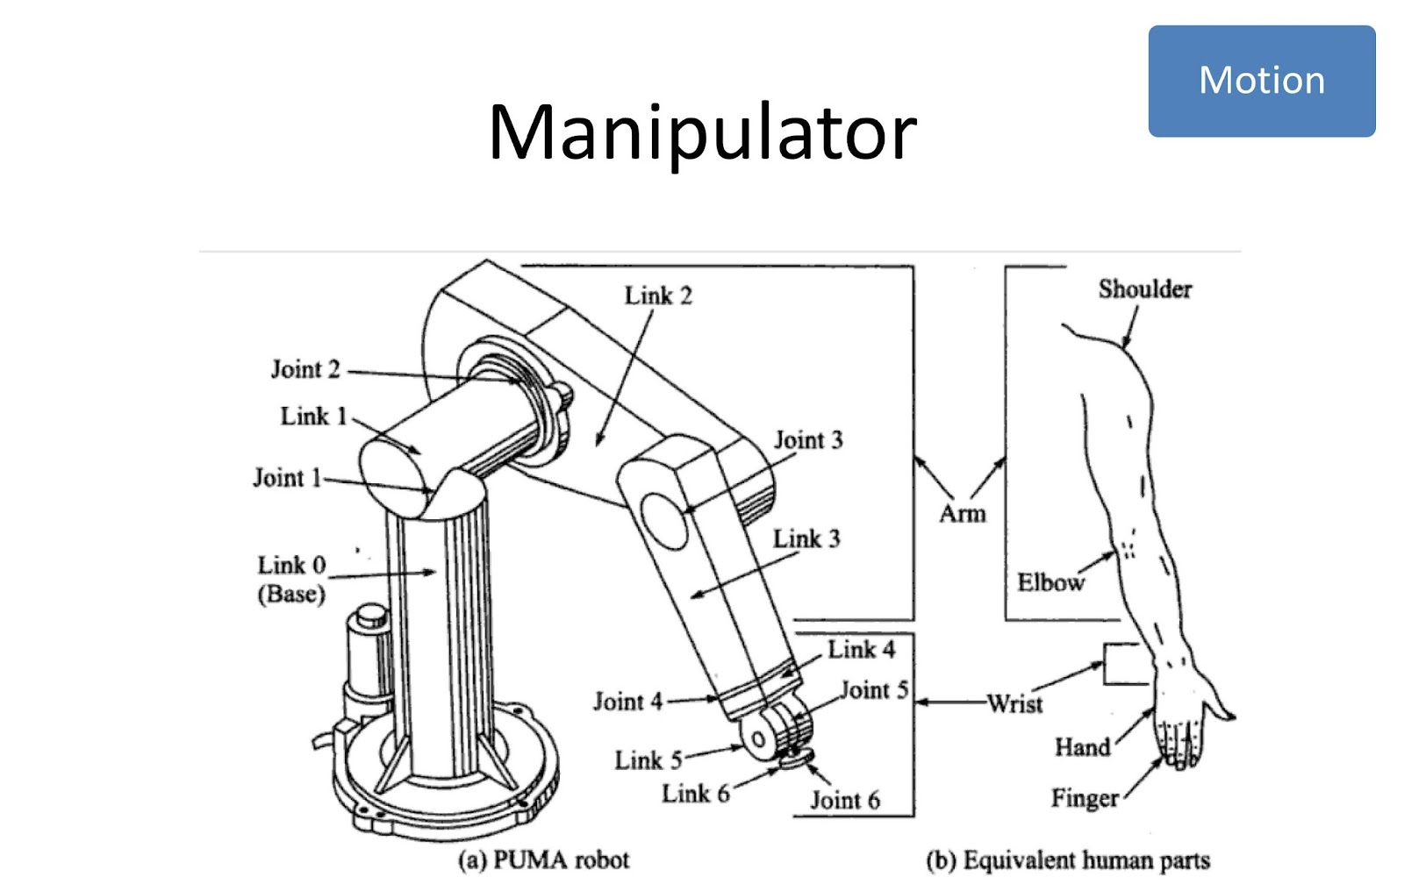

Slide 7
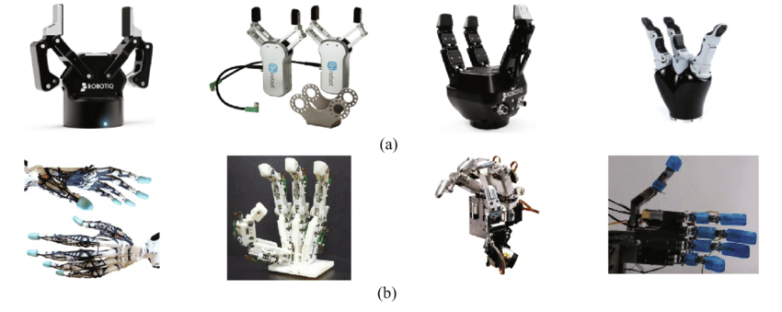
End Effector
Two types of fingered end-effectors: (a) gripper type, (b) anthropomorphic type

Slide 8
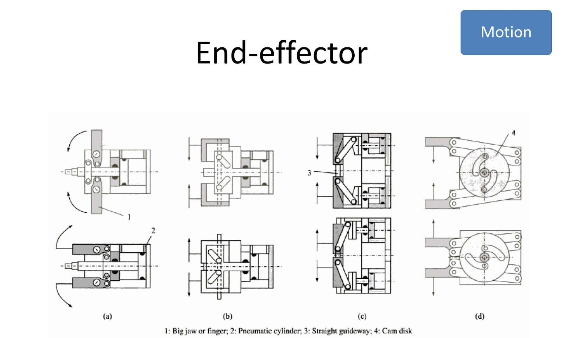

Slide 9
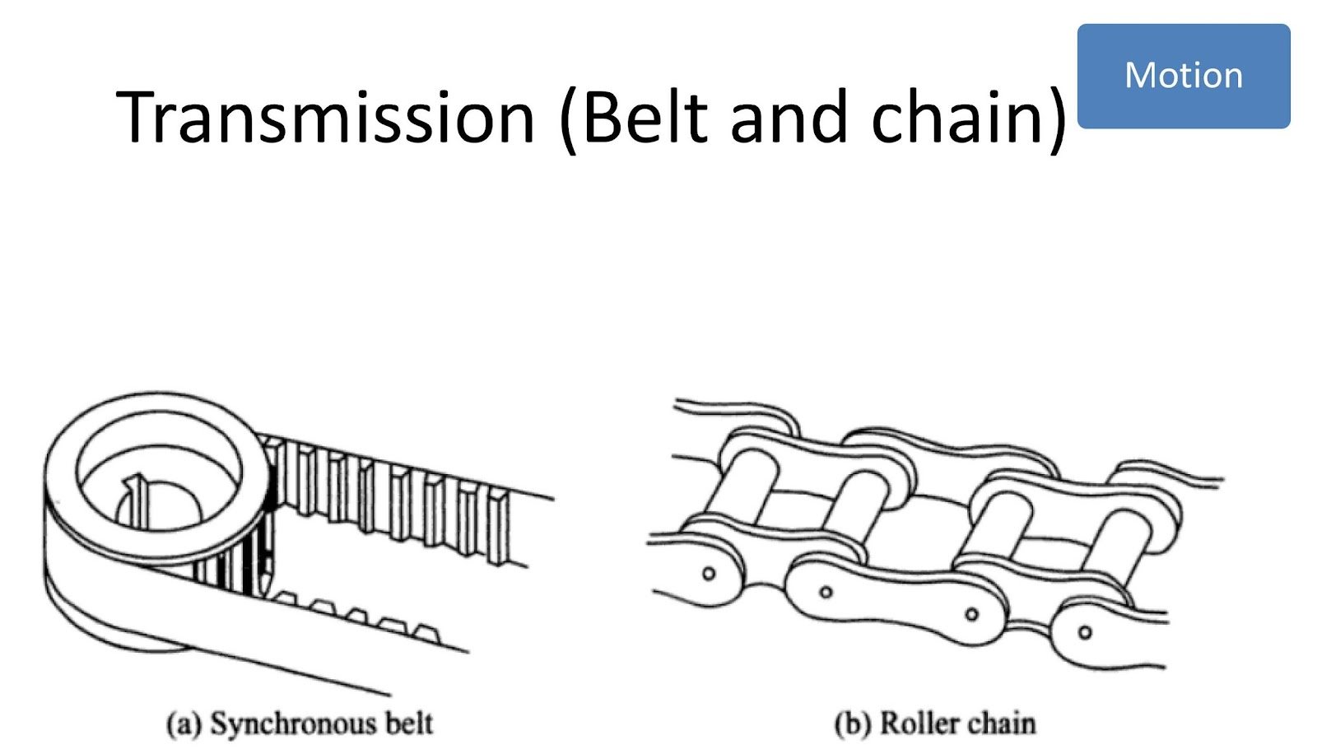

Slide 10
Categories | Synchronous Belt | Roller Chain
Efficiency | Generally more efficient, with lower friction losses | Less efficient due to higher friction and potential for more energy loss.
Noise | Quieter operation. | Noisier due to metal-on-metal contact.
Maintenance | Requires less maintenance, but belts can wear out and need replacement. | Requires regular lubrication and tension adjustment; chains are more durable but can rust and need more frequent maintenance.
Durability | More susceptible to stretching and breaking under high loads. | Better suited for high-load and high-torque applications due to its strength.
Precision | Less precise due to potential for slippage | More precise with minimal slippage, providing consistent motion
Cost | Typically cheaper to produce and replace | More expensive initially and over time due to maintenance needs
Flexibility | More flexible, can handle more complex routing | Less flexible, limited to simpler routing paths
Speed Range | Better for high-speed applications | Better for lower speed, high-torque applications
Weight | Lighter weight | Heavier due to metal construction
Environmental Resistance | More susceptible to temperature changes and can degrade with exposure to certain chemicals | More robust in harsh environments, better resistance to temperature extremes and chemicals
Elasticity | Elastic, which can dampen vibrations but may cause delay in response | Inelastic, providing more immediate response to changes in load

Slide 11
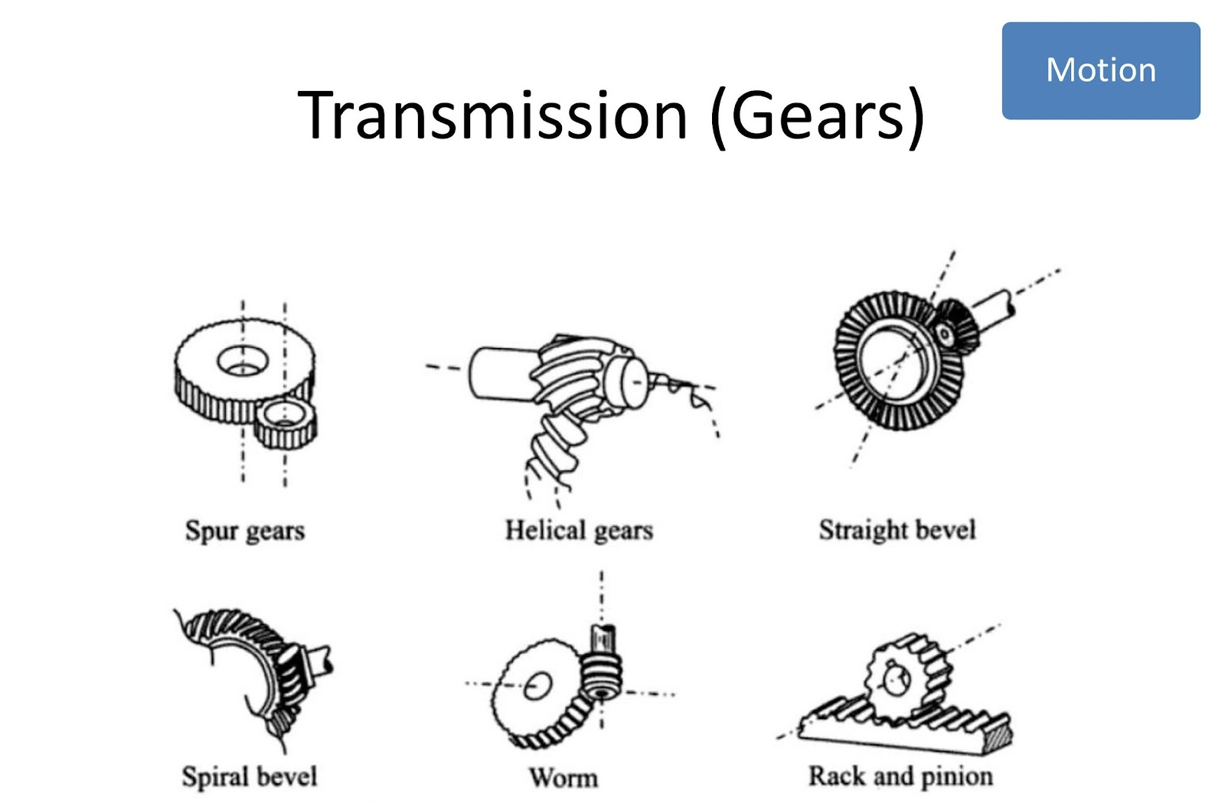

Slide 12
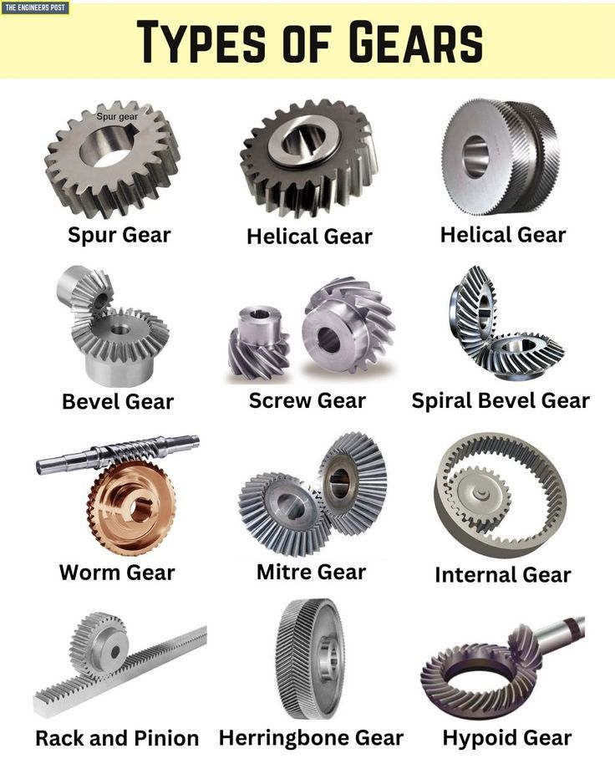
Spur Gear -
    Parallel shaft gear, cylindrical, rotary motion
    Tooth straight and parallel to shaft
    High accuracy, easy production, no load, slow
Helical Gear -
    Parallel shaft gear, cylindrical
    Winding tooth lines, better meshing
    Heavy lifting, high speed
Straight Bevel -
    Cone shaped
    Power transmitted at 90 degrees angle
Spiral Bevel -
    Cone shaped, teeths are curved
    More efficient, strong, quiet
    Harder Production
Worm -
    Screw shape cut on shaft (worm), mating gear (worm wheel)
    Can be of various shapes, power to different axis
    Low efficiency, smooth, quite, high torque
Rack and Pinion -
    Rotational to linear motion
    High precision
    High load capacity

Slide 13
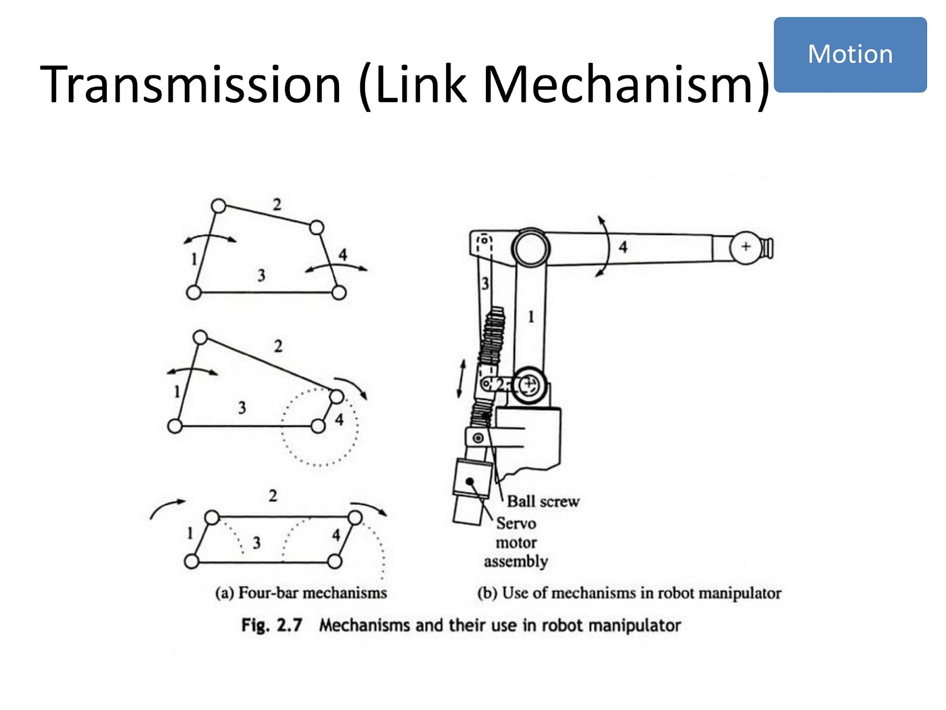

Slide 14
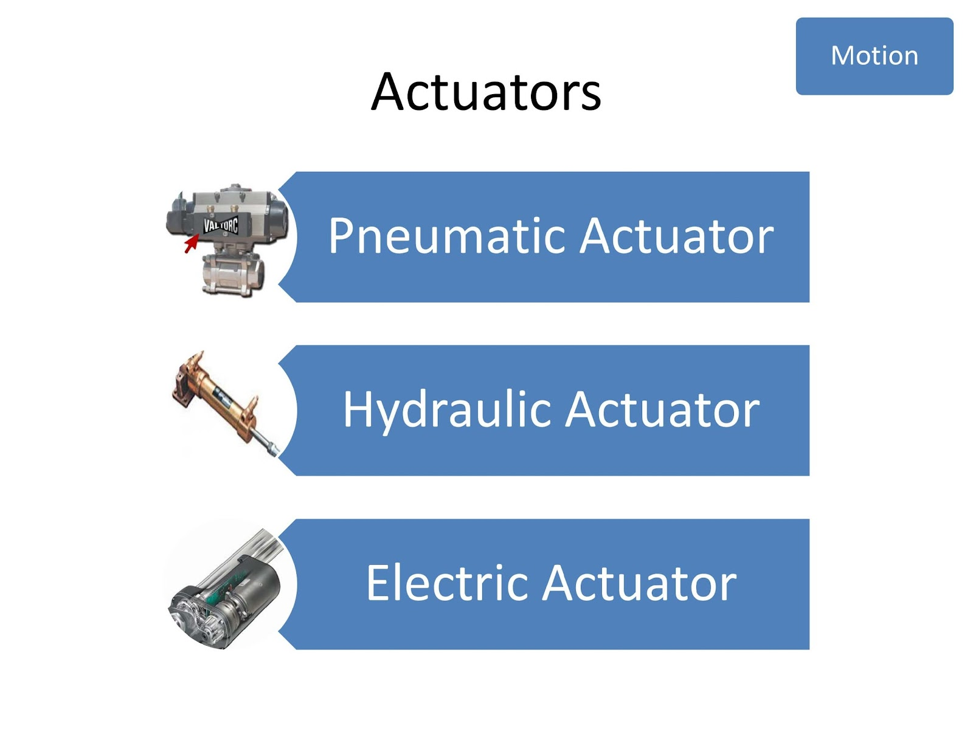

Slide 15
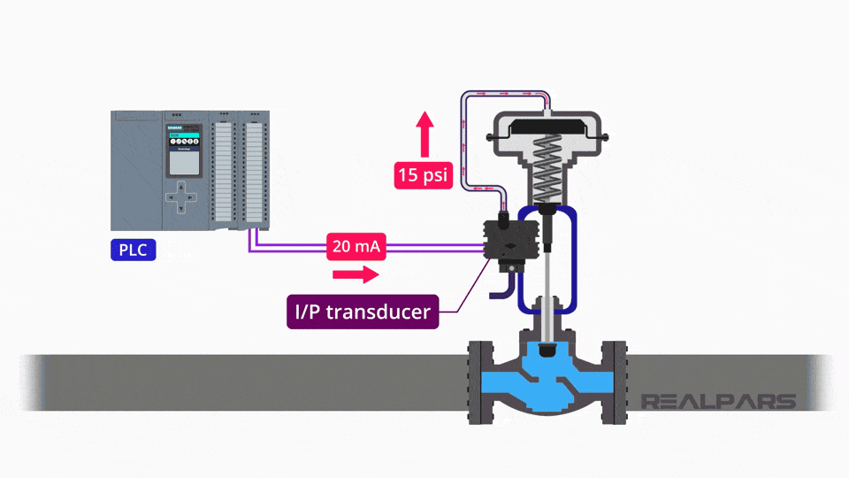
Pneumatic
Pneumatic actuators use compressed air to produce linear or rotary motion. They are fast, clean, and suitable for light to medium load applications. Commonly used in automation where speed and simplicity are important.

Slide 16
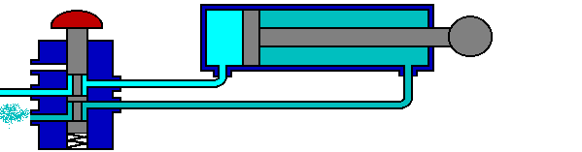
Hydraulic
Hydraulic actuators operate using pressurized fluid to generate high force and torque. They are ideal for heavy-duty applications requiring precise and powerful motion. These actuators are widely used in construction and industrial machinery.

Slide 17
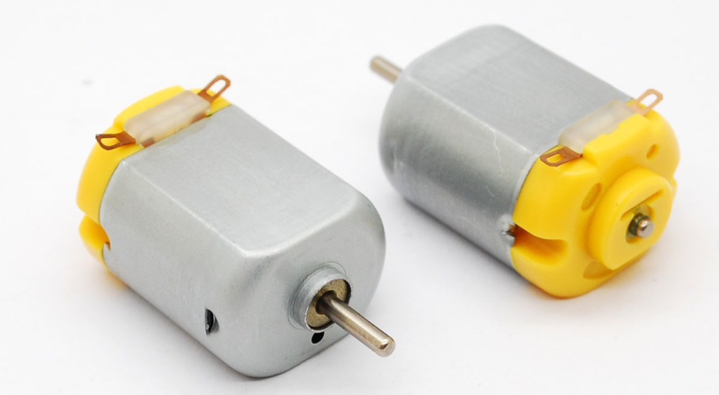
Electric
Electric actuators convert electrical energy into mechanical motion using motors. They offer high precision, easy control, and low maintenance compared to fluid-based systems. Suitable for applications requiring accurate positioning and integration with digital control systems.

Slide 18
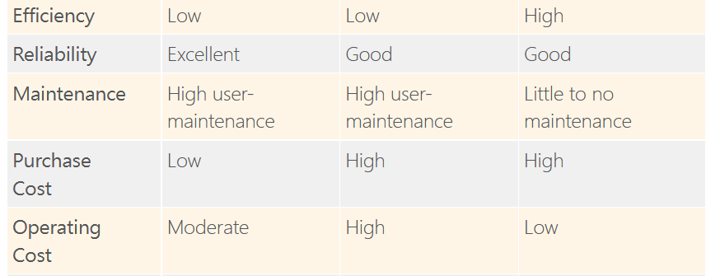
Actuators Comparison

Slide 19
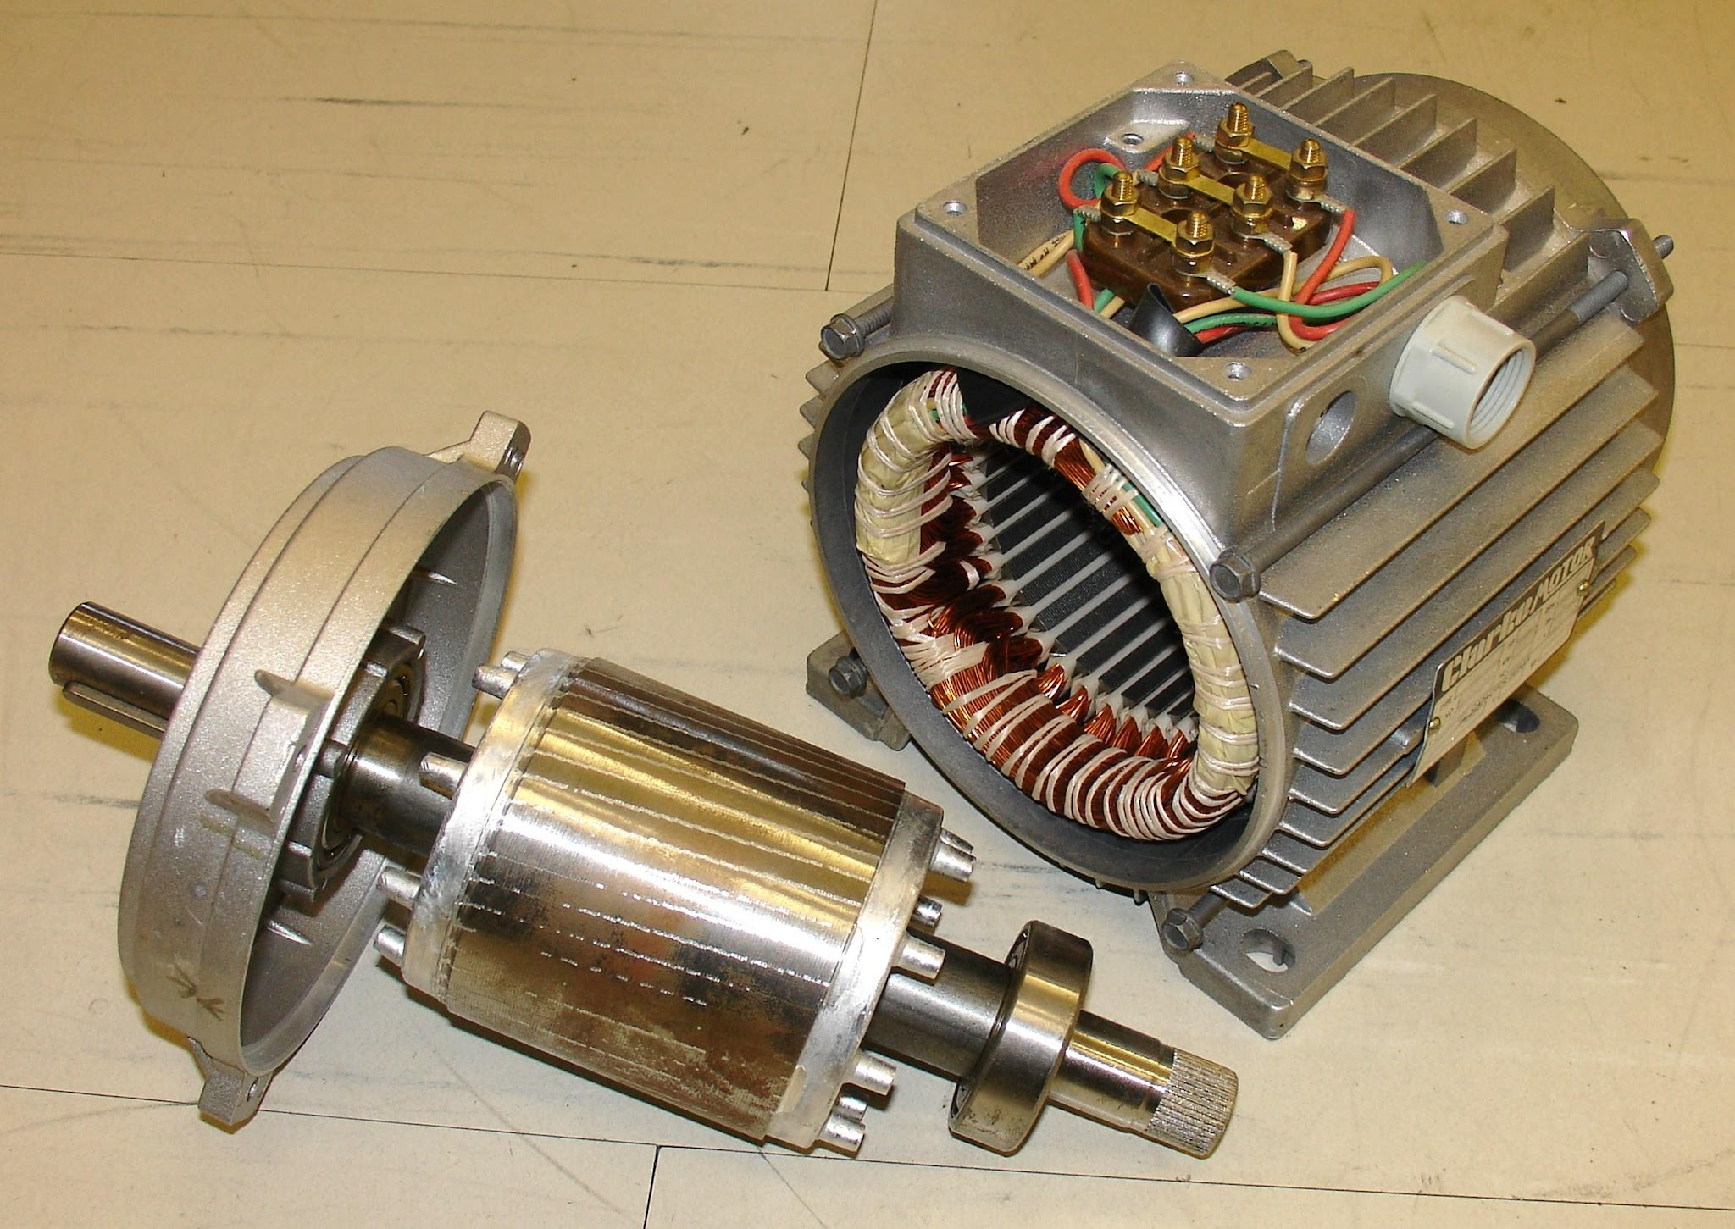
Motor
Stator
Rotor

Slide 20
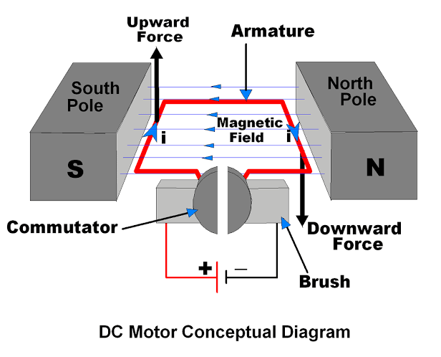
DC motor
Working mechanism: https://youtu.be/LAtPHANEfQo

Slide 21
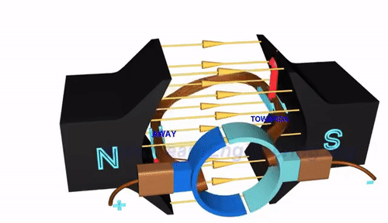
DC motor
A DC motor works by converting electrical energy into mechanical rotation through electromagnetic interaction. When current flows through the armature winding, it creates a magnetic field that interacts with the stator field, producing torque. A commutator is used to maintain continuous rotation by reversing current direction. Speed control is typically achieved by varying the supply voltage.

Slide 22
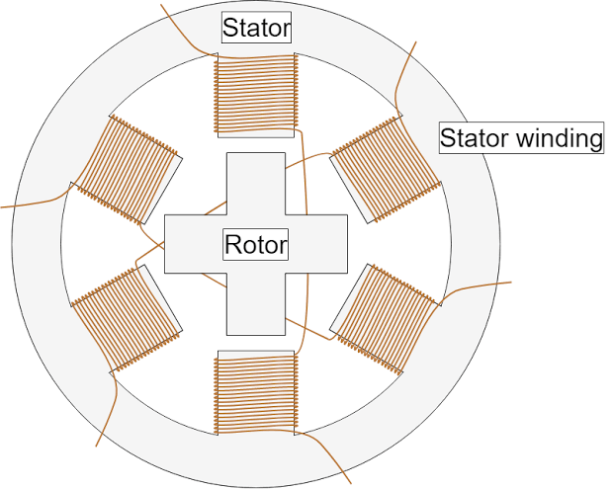
Stepper Motor
Working mechanism: https://youtu.be/eyqwLiowZiU

Slide 23
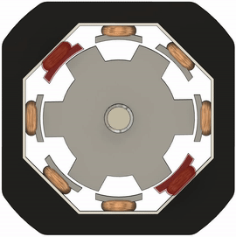
Stepper Motor
A stepper motor operates by dividing a full rotation into a series of equal, discrete steps. Sequential energizing of stator windings creates a rotating magnetic field that moves the rotor step by step. Each input pulse corresponds to a fixed angular movement, enabling precise position control. Stepper motors can hold their position without feedback when energized.

Slide 24
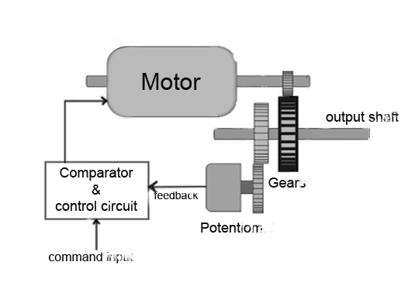
Servo Motor

Slide 25
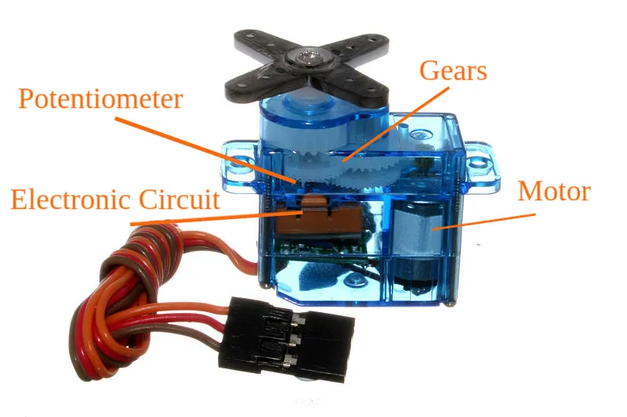
Servo Motor
A servo motor works using a closed-loop control system with feedback from a potentiometer. The controller compares the desired position with the actual position and adjusts the motor accordingly. This allows high precision and accuracy in position, speed, and torque control. Servo motors are widely used in robotics and automation where precision is critical.

Slide 26
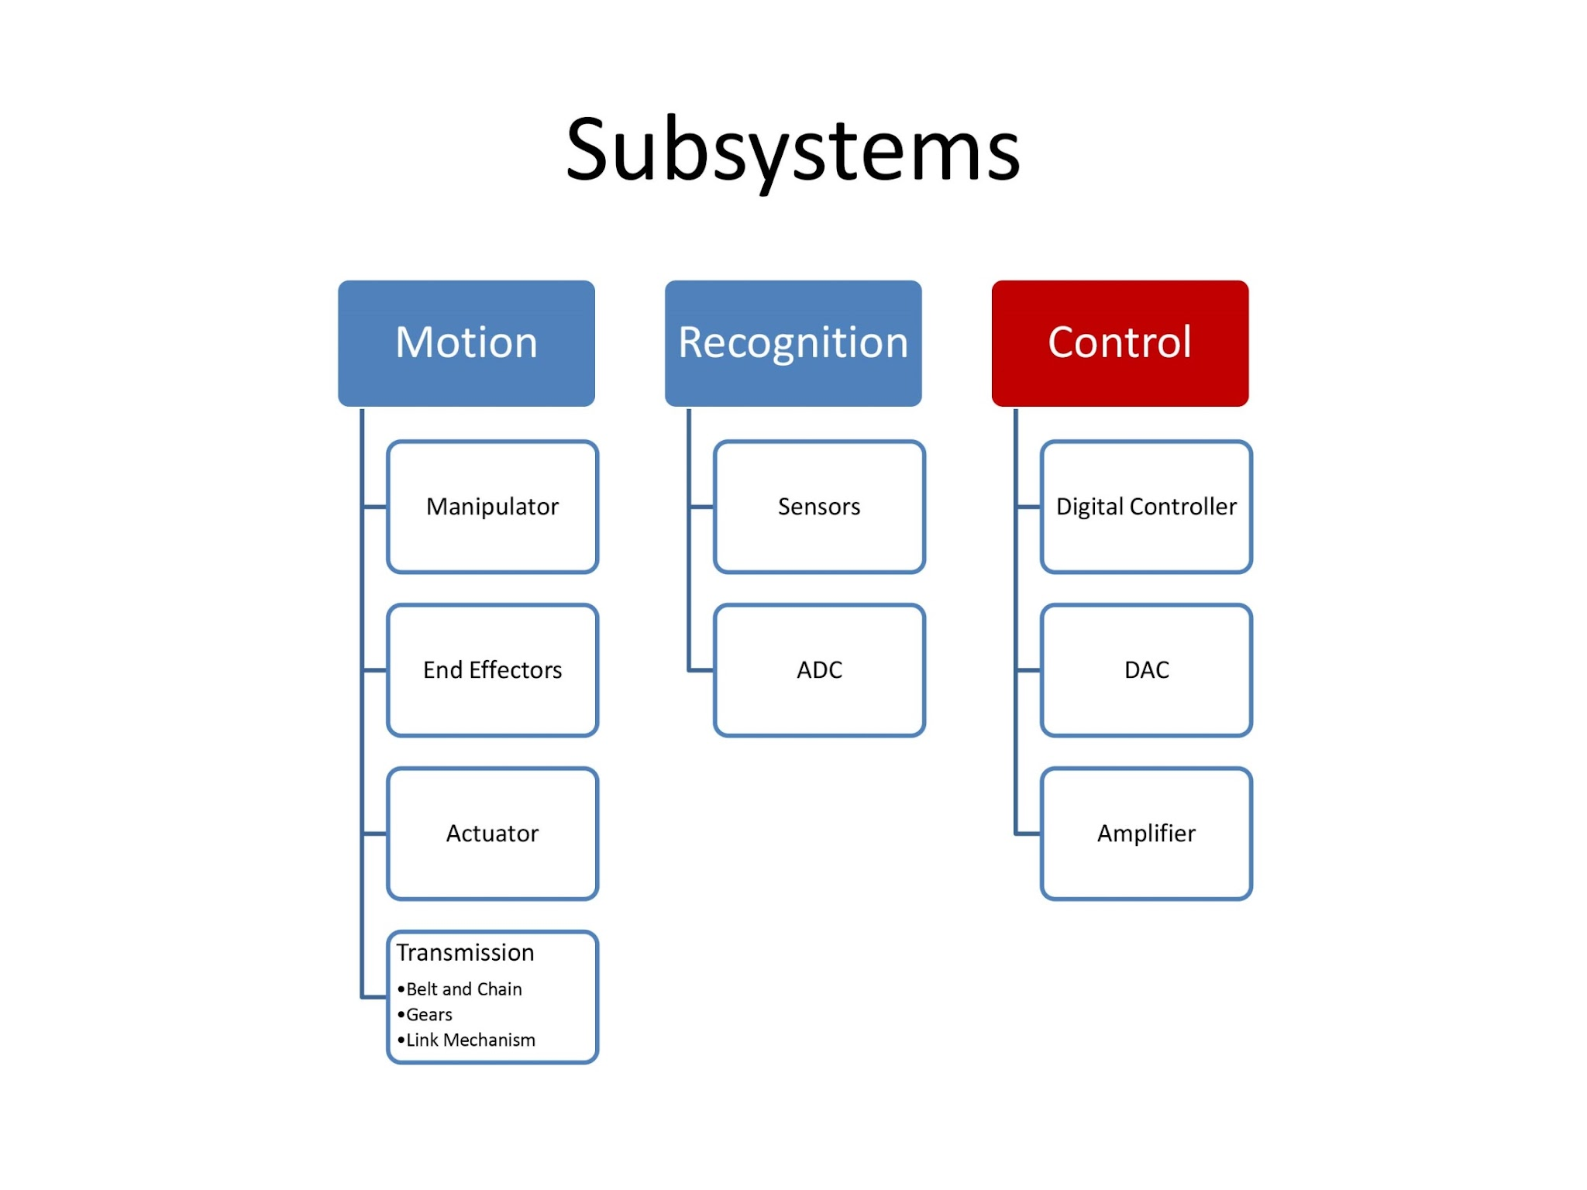

Slide 27
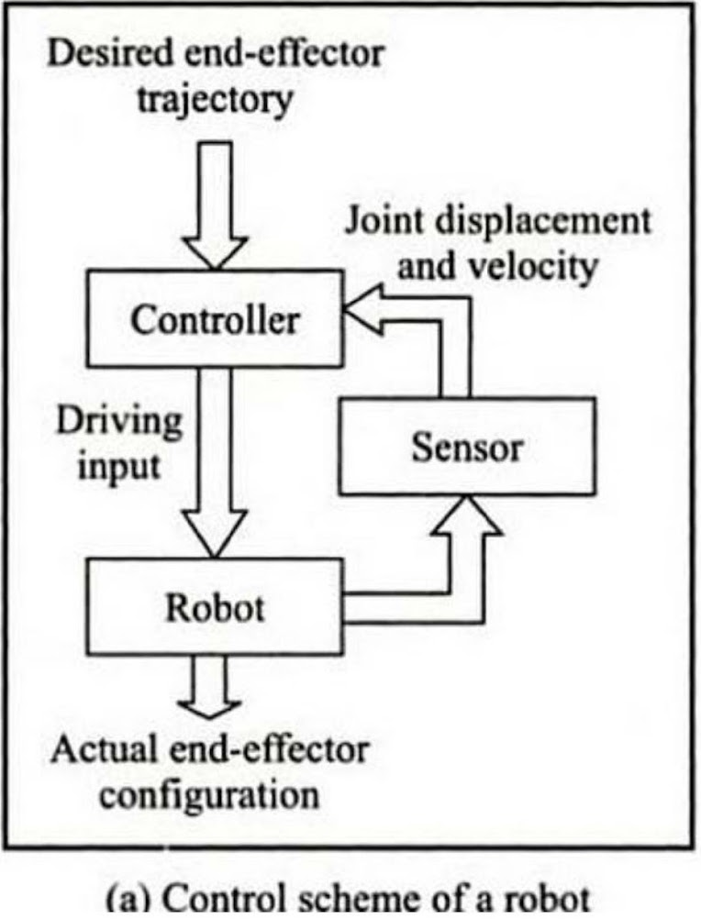
Control Software
Robot Vision
PID control
Trajectory/Motion Planning
Localization
Manipulator Control
UAV Navigation
Sensors calibration and sensor fusion
Kinematics and dynamics
Interfacing
Communication

Slide 28
Control Hardware
Microcontrollers
Arduino
PLC
FPGA
Single Board Computer
Portable PCs
Cloud Computing System

Slide 29
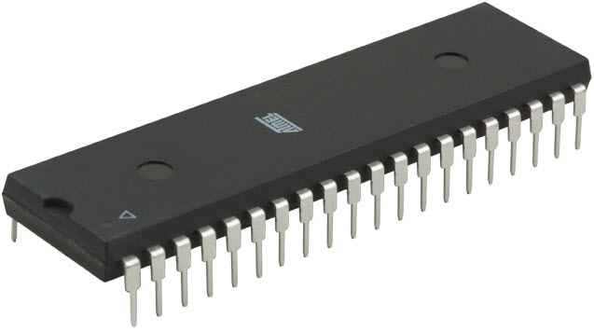
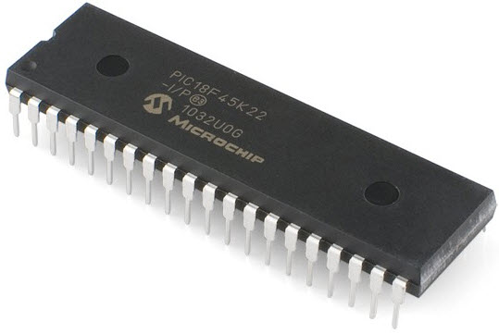
Microcontrollers
A microcontroller is a small, integrated circuit that contains a processor, memory, and input/output peripherals on a single chip. In robotics, it is used for low-level control tasks such as sensor reading, motor control, and real-time decision making in embedded systems.

Slide 30
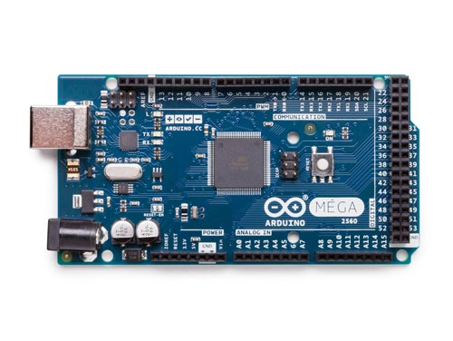

Arduino
Arduino is an open-source microcontroller platform designed for rapid prototyping and ease of use. In robotics, it is widely used for educational robots and simple control tasks like line following, obstacle detection, and actuator control

Slide 31
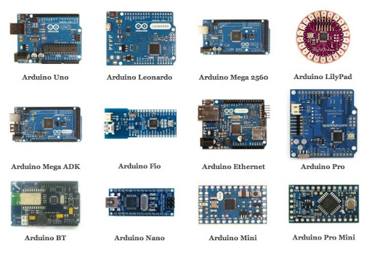
Arduino

Slide 32
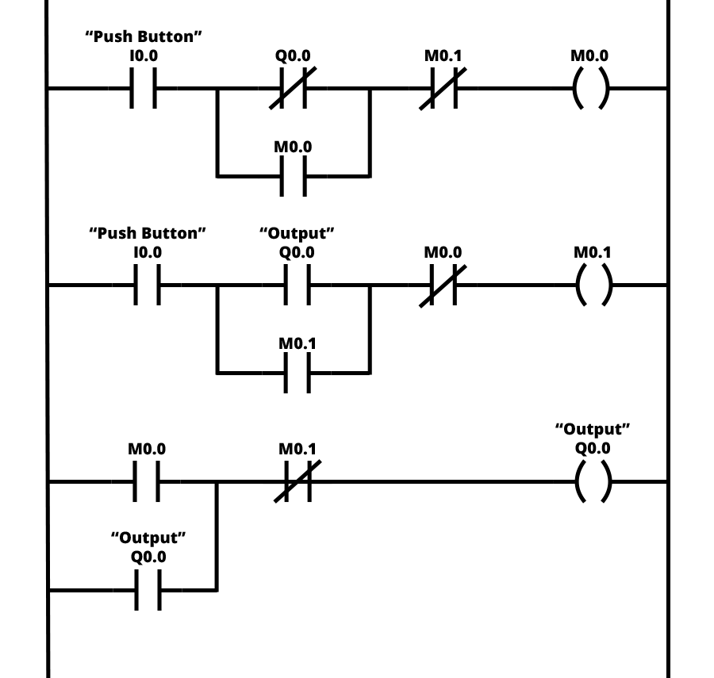
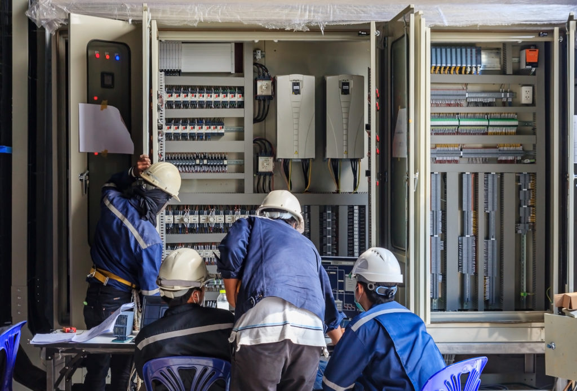
Programmable Logic Controller (PLC)
A PLC is an industrial-grade controller designed for reliable and deterministic control. In robotics, PLCs are used in industrial automation, robotic arms, and assembly lines where robustness and real-time performance are critical

Slide 33
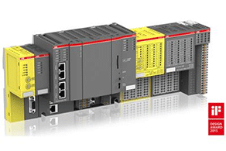
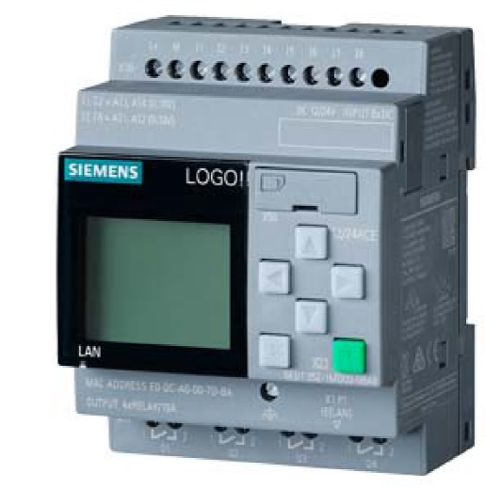
Programmable Logic Controller (PLC)

Slide 34
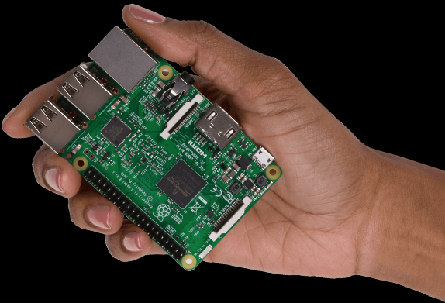
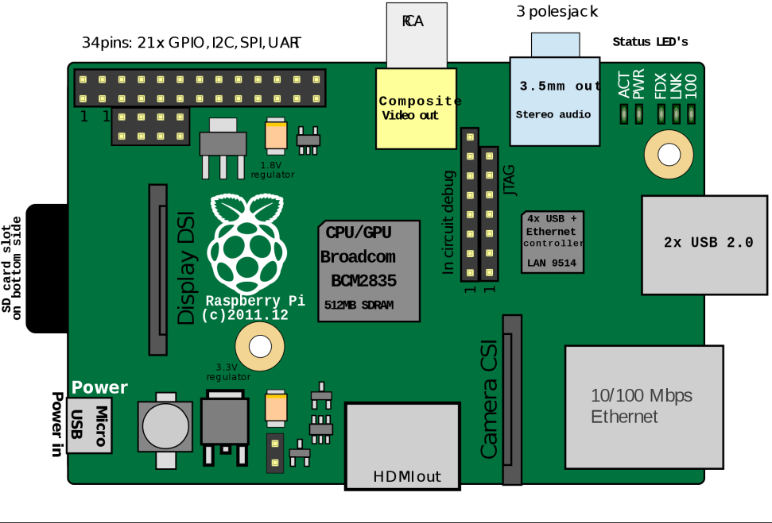
Single board Computer
An SBC is a complete computer built on a single board with an operating system. In robotics, SBCs are used for high-level tasks such as computer vision, AI inference, SLAM, and communication, often working alongside microcontrollers for low-level control.

Slide 35
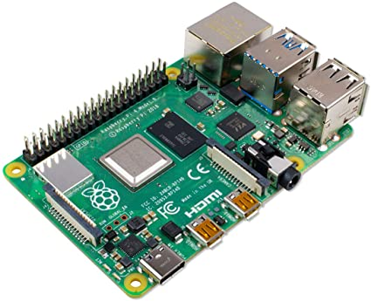
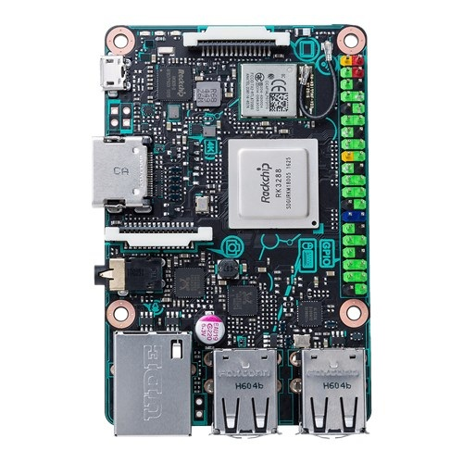
Raspberry PI 4, Tinkerboard
Raspberry Pi: Use when you need general-purpose computing and moderate robotics tasks like control, networking, and basic vision.
ASUS Tinker Board: Use when higher CPU performance and better multimedia handling than Raspberry Pi are needed.

Slide 36
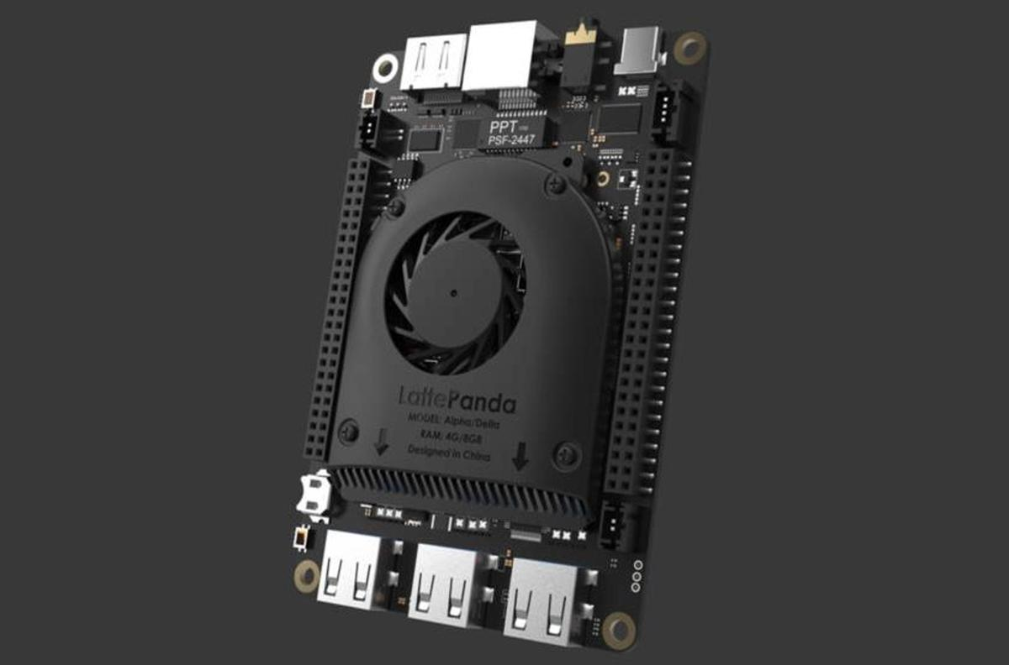
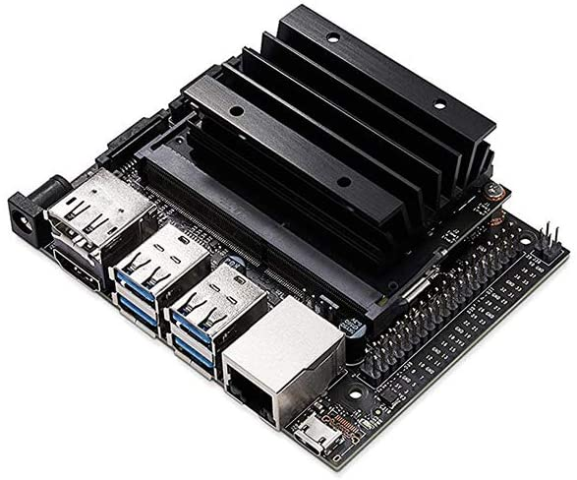
Little Panda and Jetson nano
Jetson Nano: Use when robotics applications require GPU acceleration for AI, deep learning, and real-time computer vision.
Littlepanda: Use when compact size and basic SBC functionality are sufficient for simple embedded or educational robotics projects.

Slide 37
Feature | Microcontroller | Microprocessor
Integration | Includes CPU, memory (RAM/ROM), and peripherals on a single chip | Consists mainly of CPU; external memory and peripherals are required
Cost | Low cost due to high integration | Higher cost because of additional external components
Power Consumption | Low power consumption, suitable for embedded systems | Higher power consumption
Application | Used in dedicated control-oriented applications (e.g., appliances, IoT) | Used in general-purpose computing (e.g., PCs, laptops)
Complexity | Simple hardware and software design | More complex system design
Real-time Control | Well suited for real-time and deterministic tasks | Less suitable for real-time control without additional hardware

Slide 38
Thank You

